Slide 1

Welcome (Client Name)
to our Brand Discovery
Session

Slide 2

Question 1:
What’s the name of the entity we are going to brand?
How do you want your business to be spelt out when we do your branding?

Slide 3
Question 2:
What does the business do?
If you had just 30 seconds to explain your service / product to a customer, what would you say?

Slide 4
Question 3:
Why would your customers buy your products / services?
What is the purpose of your existence?

Slide 5
Question 4:
Why was this business started?
How long have you been in business, and what made you start it.

Slide 6
Question 5:
Who are your 3 biggest competitors?
Competitor 1
Name:
Website Link:
Like / dislike about them:
Competitor 2
Name:
Website Link:
Like / dislike about them:
Competitor 3
Name:
Website Link:
Like / dislike about them:

Slide 7
Question 6:
What about your background / services / products set you apart from your competitors?
Customers are spoilt for choices. What is it about your proposition / services that would make prospects what to engage with you?

Slide 8
Question 7:
Is there a unique story behind your business or business name or logo?
People connect through stories. Storytelling is an effective way to create and sell a brand image. This could be anything from the reasoning behind your naming or any founding stories.

Slide 9
Question 8:
Describe your ideal customer?
(make copies of this slide if you want to appeal to more than 1 type of customer)
Name:
Demographics:
Gender:
Age:
Marital Status / Kids?:
Location:
Occupation (role)
Income:
Psychographics:
Hobbies:
Lifestyle:
  Fashion brands:
  Tech brands:
  Vacation:
  Music:
Personality:
  What adjectives would you use to describe them?
Insights:
Social Media behavior:
Consumer buying behavior:

Slide 10
Question 9:
How do you want to be perceived
by your ideal customers?
If they were talking to their close network, what words would you want them to describe your business?

Slide 11
Question 10:
What is the goal for the next 1 / 3 / 5 / 10 years?
Next 1 year:
3 years:
5 years:
10 years:

Slide 12
Question 11:
Please share 3 links for the brands / websites that inspire you. What do you like best about them?
These websites don’t have to be in the same industry as you. It can be any brand. We’re just trying to get a sense of your design aesthetic.
Brand 1:
Website link:
What you like:
Brand 2:
Website link:
What you like:
Brand 3:
Website link:
What you like:

Slide 13
YOUR BRAND PERSONALITY

Slide 14
Question 12:
How do you want your customers to feel after engaging with your business?
Highlight only 1
Nurtured
Empowered
Enlightened
Educational
Transformed
Informed
Hopeful
That there are opportunities
Tranquil
Peace of Mind
Satisfied
Fulfilled
Relief
Happy
Joy

Slide 15
Question 13:
If your business were a car (or animal)
what would you like it to be?
Car:
Animal:

Slide 16
Question 14:
When you think about your business,
what images come to mind?

Slide 17
Question 15:
Which are the most relevant values for your brand?
(please highlight 5)
  Authenticity
  Consistency
  Quality
  Passion
  Relevance
  Efficiency
  Innovation
  Responsibility
  Customer-Centered
  Empathy
  Community
  Integrity
  Sustainability

Slide 18
Question 16:
Which of the following adjectives best describe your brand:
  Cool
  Funny
  Aggressive
  Loyal
  Fashionable
  High-End
  Flashy
  Bold
  Imaginative
  Edgy
  Warm
  Old Fashioned
  Sexy
  Clever
  Human
  Expert
  Strategic
  Approachable
  Sophisticated
  Magical
(please highlight 5)

Slide 19
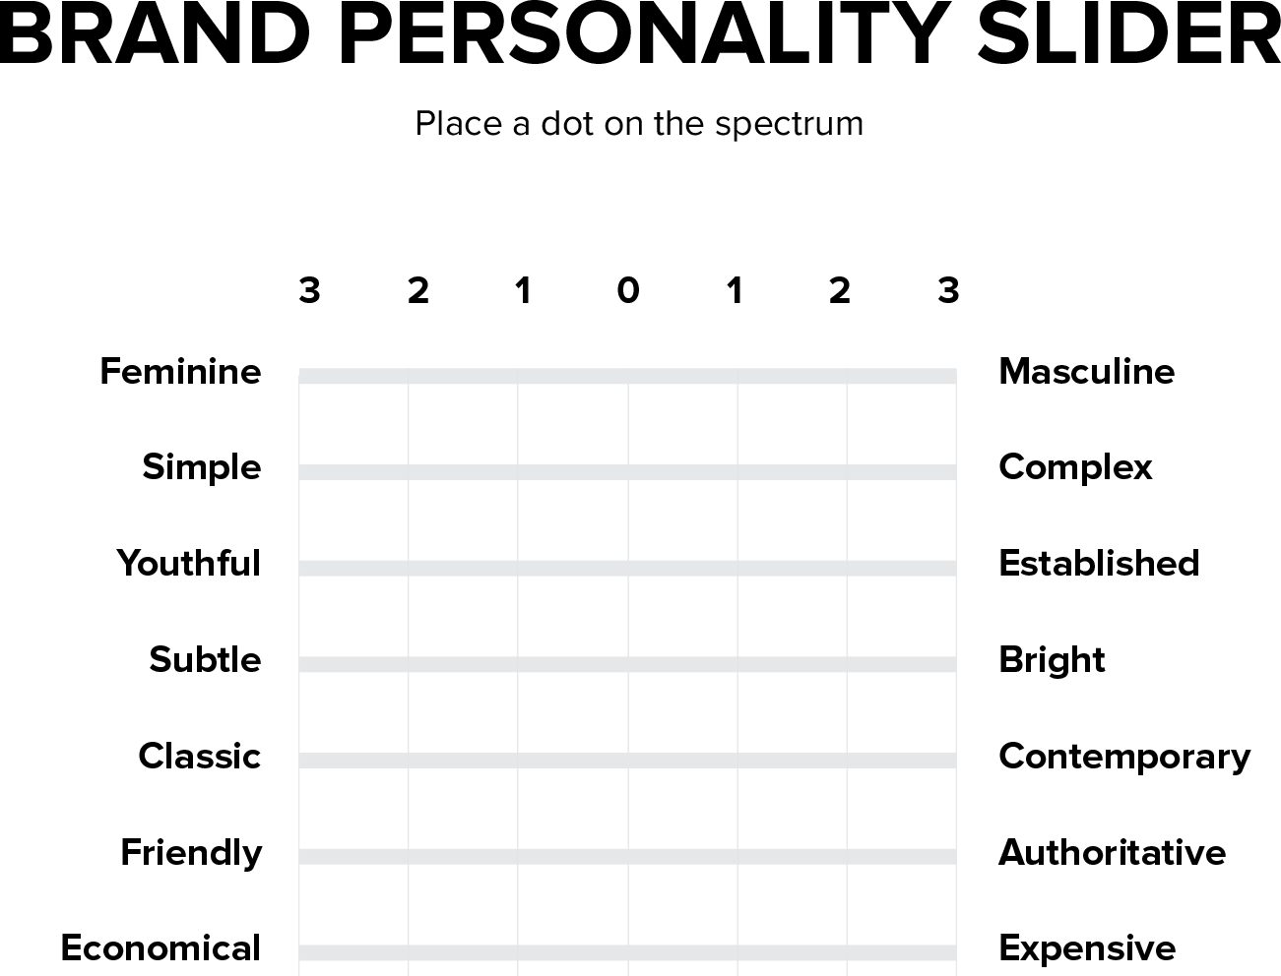
Question 17:
Brand Design Slider 1
(It can not be in the middle)

Slide 20
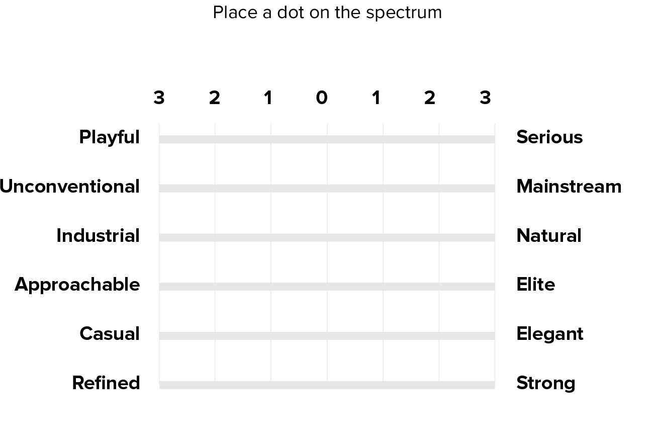
Question 18:
Brand Design Slider 2
(It can not be in the middle)

Slide 21
Question 19:
Which pair of words best describe your brand?
Please Highlight 1
  Approachable & For Everyone
  Inspirational & Magical
  Bold & Adventurous
  Passionate & Loving
  A Winner & Driven
  Imaginative & Talented
  Caring & Considerate
  Radical & Different
  Insightful & Knowledgeable
  Playful & Amusing
  Leadership & Influence
  Goodness & Happiness

Slide 22
Question 20:
How would you like your brand to be seen by your customers?
Please Highlight 1
  The Hero
  Best Friend
  Creative
  Teacher
  A Geek
  Helper
  Expert
  An Entertainer

Slide 23
Question 21:
Which of the following needs does your brand offer people?
Please Highlight 1
  Sense of belonging
  Intimacy
  Pleasure
  Knowledge
  Service
  Empowerment
  Liberation
  Safety
  Innovation
  Control
  Adventure
  Mastery

Slide 24

Question 22:
What colour would you associate with your brand?
Please Highlight 1
(if there is a particular color you have in mind, please place an image of it here.
Or if you would like us to decide for you, leave this blank.)
white
yellow
orange
green
red
purple
blue
grey
black

Slide 25
Question 23:
Does your brand focus on social values or individual values Please Highlight 1
  Social values (friendship, unity, popularity, and community)
  Individual Values (Individualism, esteem, and freedom)

Slide 26
Question 24:
Does your brand prefer …
Please Highlight 1
  Predictability and Stability?
  Risk, Change and Excitement?

Slide 27
Question 25:
How does your brand / service help people?
Please Highlight 1
  It offers people Freedom or Escapism
  It helps people have Fun and Enjoy life
  It offers Safety and Protection
  It Educates or helps people Realize their Potential
  It Motivates people to Achieve or be Better
  It helps people Create and Inspire
  It Breaks Conventions and the Status Quo
  Gives people the sense of Belonging and Acceptance
  It Transforms peoples Lives or Amazes them
  It helps people Enjoy and Realize the Child within them

Slide 28
Question 26:
Compared with your competitors,
what is your brand’s main point of difference?
Please Highlight 1
  The first (e.g. Original)
  The most successful (e.g. Biggest)
  The most effective (e.g. Improvement & Results)
  The most creative (e.g. Ideas & Products)
  The most fun (e.g. good times, humorous)
  The most popular (e.g. liked by everyone)
  The most caring (e.g. nurturing & supportive)
  The most radical (e.g. different)
  The most knowledgeable (e.g. smart, educational, intelligent)
  The most romantic (e.g. emotional, warm, passionate)
  The most adventurous (e.g. worldly, excitement, determined)
  The more wholesome (e.g. Innocent, Simple, and Good)

Slide 29
Question 27:
Anything else you’d like to tell us about your brand or business?
  Type in here

Slide 30
Thank you

